Slide 1
Designing an Educational Method Using a Model of Clinical Reasoning to Support Novice Physical Therapists Learning
Kansai University Faculty of Informatics
Graduate School of Informatics, Kansai University
Aino University
Masato Miyamoto, Mitsunori Matsushita, Hirohumi Hori
Notes:
Thank you chairman.
I‘m Masato Miyamoto, from Kansai University.
I tolk about this
“Designing an Educational Method Using a Model of Clinical Reasoning to Support Novice Physical Therapists Learning”

Slide 2
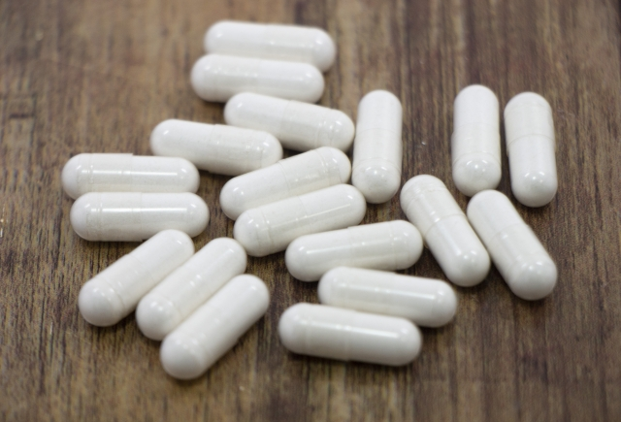
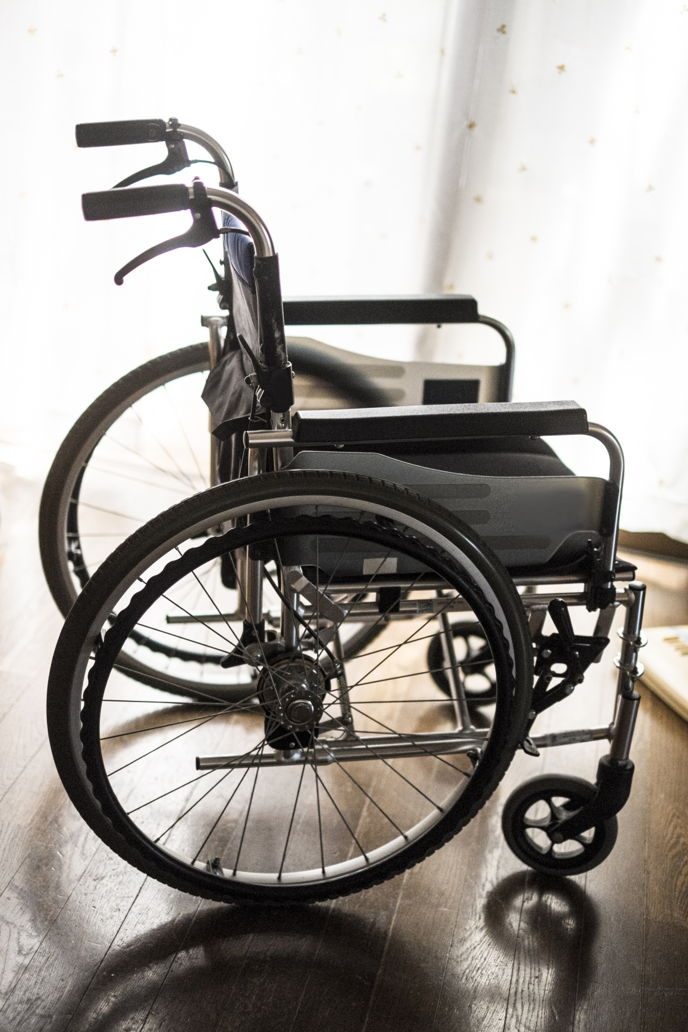
The Importance of Quality of Life(QOL)
Medical development have brought about lower mortality rates and longer lives
More Elderly people are bedridden and unable to live without nursing
Not simply without disease,
But realizing importance of QOL
Notes:
Medical development have brought about lower mortality rates and longer lives.
On the other hand, due to old age,
the risk of being bedridden or unable to live comfortably without care has become apparent
Because of these changes,
People became more interested in the quality of life rather than simply without disease
And recognize independent life for a lifetime improve quality of life

Slide 3
Rehabilitation is the Key to Improves QOL
QOL is closely related to the patient’s life without nursing
Rehabilitation enable patient to live without nursing
Occupation that implement rehabilitation
Physical therapist(PT)
・Improves patient’s disability in basic movement
(get up, walk, turn over, etc.)
・Maintains patient’s health and prevent deterioration
PT have an important role in an aging society
→Education of PT is important
Notes:
The goal of rehabilitation is to improve the patient's quality of life.
Quality of life is closely related to the patient's independent life.
Rehabilitation helps us to live independently.
The profession that specializes in rehabilitation is physical therapists.
Their approach is to improves patient’s disability in basic movement.
basic movement is, for example, get up, walk, turn over, etc.
In addition to improving the basic operation, PT maintain patient’ health and prevent deterioration.
PT have an important role in an aging society.

Slide 4
Rehabilitation Process
Information
collection
Clinical
reasoning
Rehabilitation
planning
Rehabilitation
implementation
・medical report
・inquiry
・examination
・enumerating problems
・integration and interpretation
・extracting problems
Reassessment
Notes:
This is rehabilitation process. Rehabilitation is carried out in four main steps.
First, PT collect information of patient from medical report and inquiry and examination.
Next step is called “clinical reasoning”. In this step, PT interpret the information collected. It's complex, ambiguous, and individual.
In the planning rehabilitation, the patient's goal setting and training items are determined.
And In the rehabilitation implementation, PT implement rehabilitation for patient.
In addition, PT reassessment the rehabilitation progress step by step.

Slide 5
Rehabilitation process
Information
collection
Clinical
reasoning
Rehabilitation
planning
Rehabilitation
implementation
・medical report
・inquiry
・examination
・enumerating problems
・integration and interpretation
・extracting problems
Reassessment
Notes:
In this study, we focus on clinical reasoning.
This is because the complexity of clinical reasoning poses a major problem for PT.

Slide 6
Why Clinical Reasoning So Complex?
Patients have diverse background
・Physical problems
(e.g. Pain in the legs, inability to bend the knees, etc.)
・Social problems
(e.g. perform household chores, etc.)
Clinical reasoning is not systematized
・Knowledge is empirically treated and not centralized
Instruction differs each institution and hospital
Notes:
Why clinical reasoning so complexity?
One factor is the diversity of patients' backgrounds.
The patient's background includes physical and social problems, which interact with each other.
The other factor is that clinical reasoning is not systematization.
In this field, knowledge is treated “empirically” and not centralized.
Due to these factors, clinical reasoning is complex, and as a result, instruction differs each institution and hospital. This is problem.

Slide 7
Clinical Reasoning Complexity Makes
PT’s Education Challenging
To experience clinical reasoning complexity in clinical settings
is the most effective method of PT’s education
PT students cannot experience this complexity in school
→Most of novice PT confused by the difference
between the school and clinical settings
Moreover instructors are unaware of effective educational methods
For both of novice PT and instructor,
teaching empirical knowledge is challenging
Notes:
The most effective method of PT’s education is to experience clinical reasoning complexity in clinical settings.
On the other hand, PT students cannot experience this complexity in school.
As a result, Almost of novice PT confused by the difference between the school and clinical settings
Moreover, instructors are unaware of effective educational methods
Education done empirically is educational challenging for both of novice PT and instructor,

Slide 8
Related works:
Systematizing knowledge of physiotherapy and
supporting PT student’s learning
Luiciana et al.
・Systematized knowledge of physiotherapy using Ontology
(extracted from 3 experienced PTs)
・Educational support for student learning
・Ontology is that
a method of describing human knowledge in terms of concepts and relationships between concepts
No consensus with clinical settings
Notes:
A previous study, by Luiciana, systematized knowledge of physiotherapy using Ontology, and support physiotherapy student learning.
Ontology is method of describing human knowledge in terms of concepts and relationships between concepts.
But they couldn’t get consensus with clinical settings.

Slide 9
Educational needs of novice PT and their instructor
Needs of novice PT
・To clarify the claim and their criteria
Needs of their instructor
・To explain their thought process in an understandable way
This study introduces thinking model to clinical reasoning,
to make their interaction explainable and understandable
Notes:
Indicates the needs of novice PT and their instructor in physical therapy education
Needs of novice PT is to clarify instructor’s claim and their criteria.
And needs of instructor is to explain their thought process in an understandable way for novice PT.
This study introduces thinking model to clinical reasoning, to make their interaction explainable and understandable.

Slide 10
We used Toulmin as a thinking model
A thinking model that visualizes the logical structures used for argument and reasoning
Ground
Conclusion
he has pneumonia.
He needs penicillin
treatment.
Backing
Warrant
Previous medical
studies have demo-
nstrated the efficacy
Penicillin treatment
is effective
for pneumonia.
e.g. Medical reasoning based on toulmin model
Notes:
Introduce one thought model here.
Toulmin model is a thinking model that visualizes the logical structures used for argument and reasoning.
Toulmin model has 4 elements, ground, conclusion, warrant, and backing.
Here is an example of clinical reasoning using the Toulmin model.
He has pneumonia. He needs penicillin treatment.

Slide 11
Our proposal: clinical reasoning model
→Based on this, design an educational system for novice PT
Notes:
We propose clinical reasoning model based on Toulmin model.
Using clinical reasoning model, to formulate the structure of the logical thinking of physiotherapist.
And we design an educational system for novice physiotherapist based on clinical reasoning model.

Slide 12
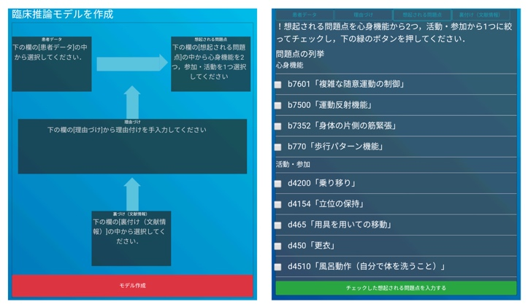
Educational system
System interface
・User select items
from select area
by checkbox
・Items is reflected in
model area
Model area
Select area
Notes:
Educational system proposed by this study is web application for smartphone.
Figure is system interface. User select items from select area by checkbox, and Items is reflected in model area.
This system enable user to create clinical reasoning model on the system.

Slide 13

Educational system: interaction flow
Web application
that learner construct clinical reasoning and get feedback
(the model inputed by instructor)
the setting & the model
create the model
proposal system
Instructor
feedback
Learner
Notes:
Here is interaction flow.
Instructor inputs the settings of the simulated patient.
And instructor inputs clinical reasoning model.
Learner confirm the setting of the simulated patient.
And learner construct clinical reasoning model.
System give learner feedback which inputed by instructor.
And system collect clinical reasoning model data.

Slide 14
Experiment
Evaluate educational system usability
・Seven physiotherapists(2–6 years of experience)
(1)Participants access web application
(2)System present simulated patient data to participants
(3)Participants construct clinical reasoning model
(4)Participants answered usability questionnaire
Notes:
We asked seven physiotherapists in the clinical setting to use the system and asked usability questionnaires and users’ comment.
First, Participants access web application.
Next, system present simulated patient data to participants.
Participants construct clinical reasoning model.
Finally participants answered usability questionnaire.

Slide 15
Discussion
Usability evaluation
・Users can easily create a clinical
  reasoning model on the system
・The feedback by the system
was useful

Slide 16
Discussion
Usability evaluation
・Users can easily create a clinical
  reasoning model on the system
・The feedback by the system
was useful
Notes:
“ease of operation” and “Is it easy to create a model using this system?” is 60% positive
→Users can easily create a clinical reasoning model on the system
“Is the feedback provided by using this system useful?” is 60% positive
→The feedback by the system was useful
“I can see the information I see and think about, and I can organize it. I could organize my thoughts by formulating with a focus on the logical structure of reasoning.” by free description
→Users organized one’s thought using clinical reasoning model

Slide 17
Discussion
Usability evaluation
・Users can easily create a clinical
  reasoning model on the system
・The feedback by the system
was useful
Notes:
“ease of operation” and “Is it easy to create a model using this system?” is 60% positive
→Users can easily create a clinical reasoning model on the system
“Is the feedback provided by using this system useful?” is 60% positive
→The feedback by the system was useful
“I can see the information I see and think about, and I can organize it. I could organize my thoughts by formulating with a focus on the logical structure of reasoning.” by free description
→Users organized one’s thought using clinical reasoning model

Slide 18
Discussion
The usefulness of the clinical reasoning model
・ Users organized one’s thought using clinical reasoning model
→ by user’s comment
Improvements in the system
・ The user interface could be improved further
→ by usability questionnaire and users’ comment
Notes:
“arrangement of models, selection columns, buttons, etc.,” “operation method,” and “ease of operation” isn’t positive
“difficult to press buttons” by free description
→The user interface could be improved further

Slide 19
Summary
The purpose
To systematize knowledge of clinical reasoning for PT education
The proposal
・Defining clinical reasoning model based on Toulmin model
・Designing educational system using the model
Notes:
This is summary of this study.
Thank you for lissoning.

