Slide 1
入力例１に対する 動作の説明

Slide 2
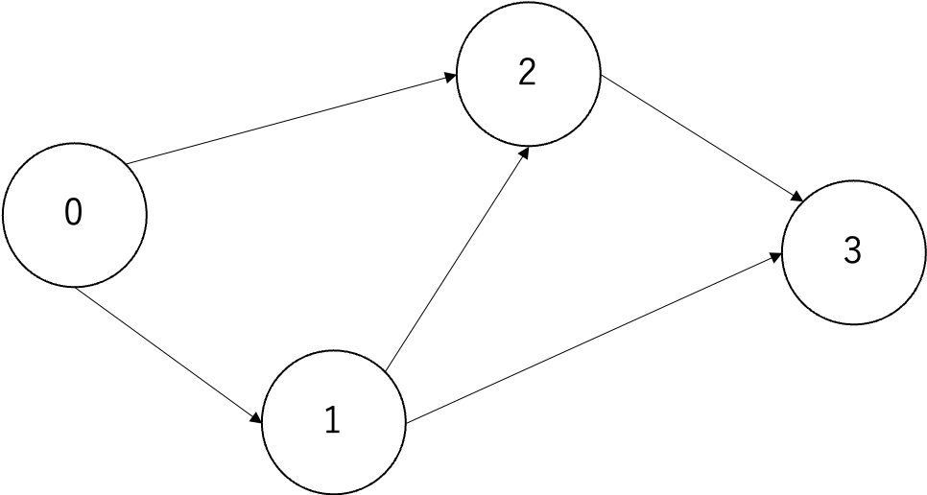
Graph = [[1, 2],
[3, 0, 2],
[1, 0, 3],
[1, 2]]
0
初期値
que = [0]
dist = [0, None, None, None]
cnt = [1, 0 , 0, 0]
1
2
3

Slide 3
Graph = [[1, 2],
[3, 0, 2],
[1, 0, 3],
[1, 2]]
赤の街が１つ目のforが
参照している部分
0
肌色の街が２つ目のforで
参照する予定の部分
que = [0]
dist = [0, None, None, None]
cnt = [1, 0 , 0, 0]
1
2
3

Slide 4
Graph = [[1, 2],
[3, 0, 2],
[1, 0, 3],
[1, 2]]
0
オレンジ色の街が２つ目のforが
参照している予定の部分
que = [0, 1]
dist = [0, 1, None, None]
cnt = [1, 1 , 0, 0]
1
2
3

Slide 5
Graph = [[1, 2],
[3, 0, 2],
[1, 0, 3],
[1, 2]]
0
que = [0, 1, 2]
dist = [0, 1, 1, None]
cnt = [1, 1 , 1, 0]
1
2
3

Slide 6
Graph = [[1, 2],
[3, 0, 2],
[1, 0, 3],
[1, 2]]
0
que = [0, 1, 2]
dist = [0, 1, 1, None]
cnt = [1, 1 , 1, 0]
1
2
3

Slide 7
Graph = [[1, 2],
[3, 0, 2],
[1, 0, 3],
[1, 2]]
0
que = [0, 1, 2, 3]
dist = [0, 1, 1, 2]
cnt = [1, 1 , 1, 1]
1
2
3

Slide 8
Graph = [[1, 2],
[3, 0, 2],
[1, 0, 3],
[1, 2]]
0
que = [0, 1, 2, 3]
dist = [0, 1, 1, 2]
cnt = [1, 1 , 1, 1]
1
2
何もしない
3

Slide 9
Graph = [[1, 2],
[3, 0, 2],
[1, 0, 3],
[1, 2]]
0
que = [0, 1, 2, 3]
dist = [0, 1, 1, 2]
cnt = [1, 1 , 1, 1]
1
2
何もしない
3

Slide 10
Graph = [[1, 2],
[3, 0, 2],
[1, 0, 3],
[1, 2]]
0
que = [0, 1, 2, 3]
dist = [0, 1, 1, 2]
cnt = [1, 1 , 1, 1]
1
2
3

Slide 11
Graph = [[1, 2],
[3, 0, 2],
[1, 0, 3],
[1, 2]]
0
que = [0, 1, 2, 3]
dist = [0, 1, 1, 2]
cnt = [1, 1 , 1, 1]
1
2
何もしない
3

Slide 12
Graph = [[1, 2],
[3, 0, 2],
[1, 0, 3],
[1, 2]]
0
que = [0, 1, 2, 3]
dist = [0, 1, 1, 2]
cnt = [1, 1 , 1, 1]
1
2
何もしない
3

Slide 13
Graph = [[1, 2],
[3, 0, 2],
[1, 0, 3],
[1, 2]]
0
que = [0, 1, 2, 3]
dist = [0, 1, 1, 2]
cnt = [1, 1 , 1, 2]
1
2
3

Slide 14
Graph = [[1, 2],
[3, 0, 2],
[1, 0, 3],
[1, 2]]
0
que = [0, 1, 2, 3]
dist = [0, 1, 1, 2]
cnt = [1, 1 , 1, 2]
1
2
何もしない
3

Slide 15
Graph = [[1, 2],
[3, 0, 2],
[1, 0, 3],
[1, 2]]
0
que = [0, 1, 2, 3]
dist = [0, 1, 1, 2]
cnt = [1, 1 , 1, 2]
1
2
何もしない
3

Slide 16
Graph = [[1, 2],
[3, 0, 2],
[1, 0, 3],
[1, 2]]
0
que = [0, 1, 2, 3]
dist = [0, 1, 1, 2]
cnt = [1, 1 , 1, 2]
1
2
何もしない
3

Slide 17
Graph = [[1, 2],
[3, 0, 2],
[1, 0, 3],
[1, 2]]
0
que = [0, 1, 2, 3]
dist = [0, 1, 1, 2]
cnt = [1, 1 , 1, 2]
1
2
何もしない
3

Slide 18
Graph = [[1, 2],
[3, 0, 2],
[1, 0, 3],
[1, 2]]
0
que = [0, 1, 2, 3]
dist = [0, 1, 1, 2]
cnt = [1, 1 , 1, 2]
1
2
最終的な答え → ２
3

